Slide 1
Task4 – Image to Pencil Sketch
Lets Grow More – Data Science Internship
Vijayanagara Sharanya

Slide 2
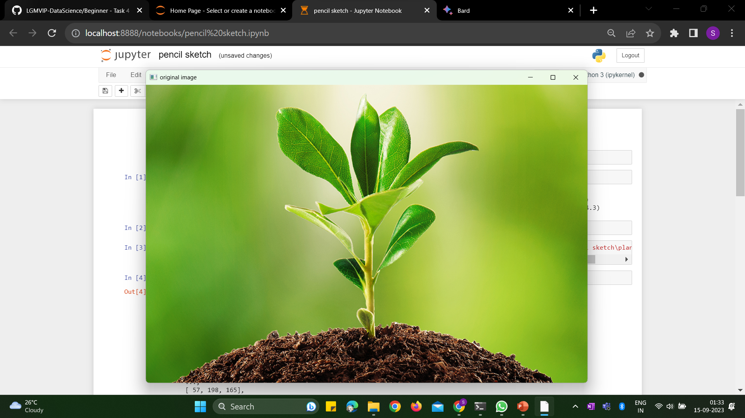
Original Image

Slide 3
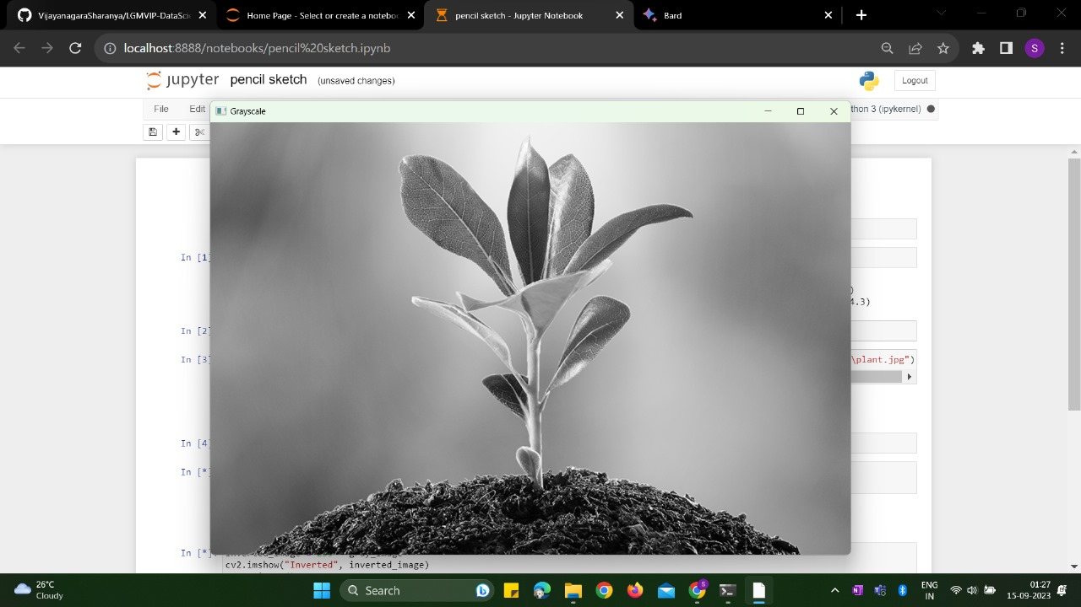
Gray Scale Image

Slide 4
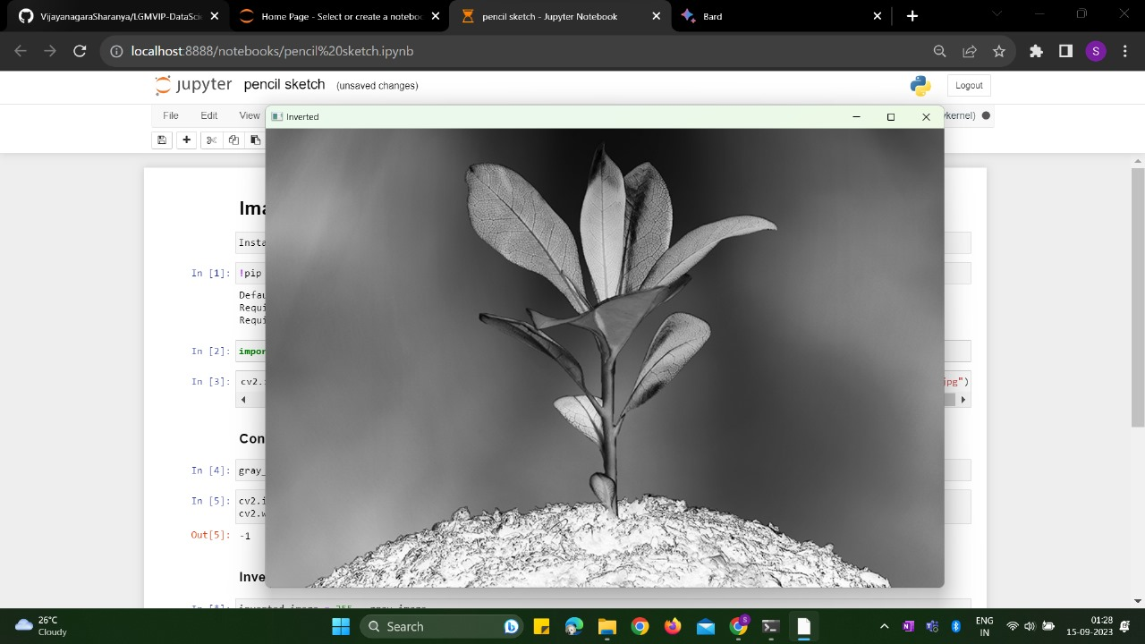
Inverted Image

Slide 5
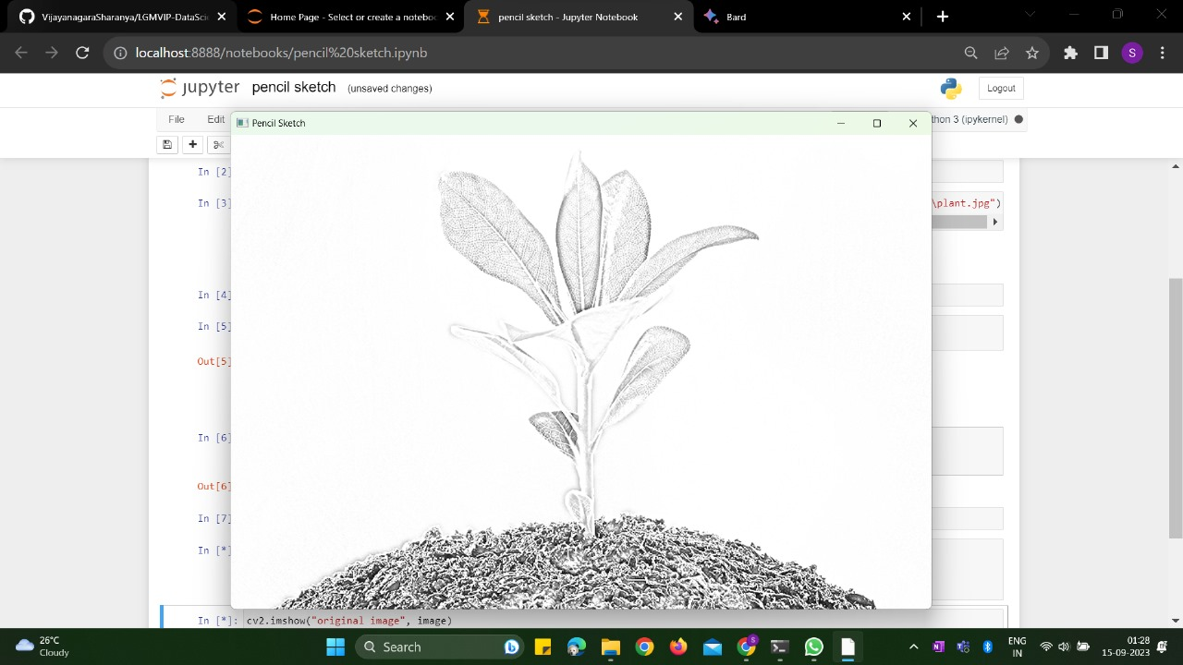
Pencil Sketch Image

Slide 6
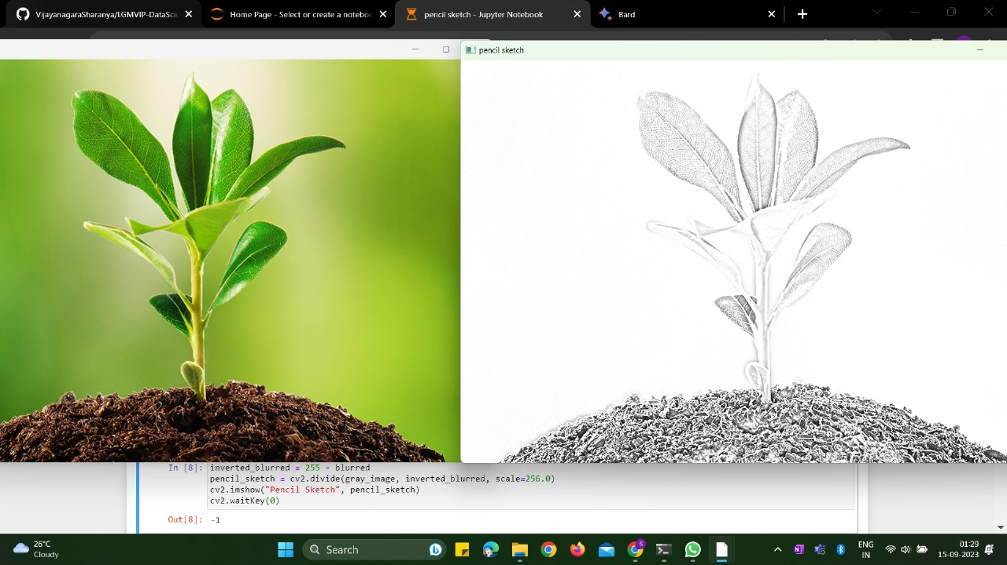
Original Image and Pencil Sketch Image

